Slide 1
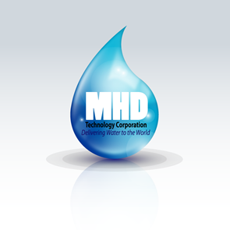
MHD TECHNOLOGY CORPORATION

Slide 2
MHD’s Technology
MHD has developed a desalination technology that brings unlimited quantities of desalinated water for drinking and irrigation to any area of the world.
MHD is a water transport and desalination company that economically moves the saltwater through a pipeline, while also desalinating the water inside the pipeline.
MHD can do this because we do not have to build expensive desalination plants. We desal inside the pipeline, and we do not have to buy millions of dollars of electricity to desalinate the water because our desal units produce their own electricity.
(video animation on next slide)

Slide 3
MHD’s Technology
Our desalination technology is based upon a 1967 patent covering a dredging device that generated an incredibly powerful water flow rate of 20,000 gallons per minute through a 12-inch pipeline, which is far above what any other dredge could achieve. It is scalable, with larger diameter pipes able to carry 60,000 or 80,000 gallons per minute. A demo prototype was tested in 1967 for the US Navy and performed perfectly. (see slide #9)
MHD re-purposed the dredge by simply turning the pipe around 180 degrees, so the water is being pushed, not being suctioned. We added turbines so the powerful flow rate also generated electricity. Part of that electricity goes to running the system making the desal unit self-supporting, needing no outside grid electricity to function.

Slide 4
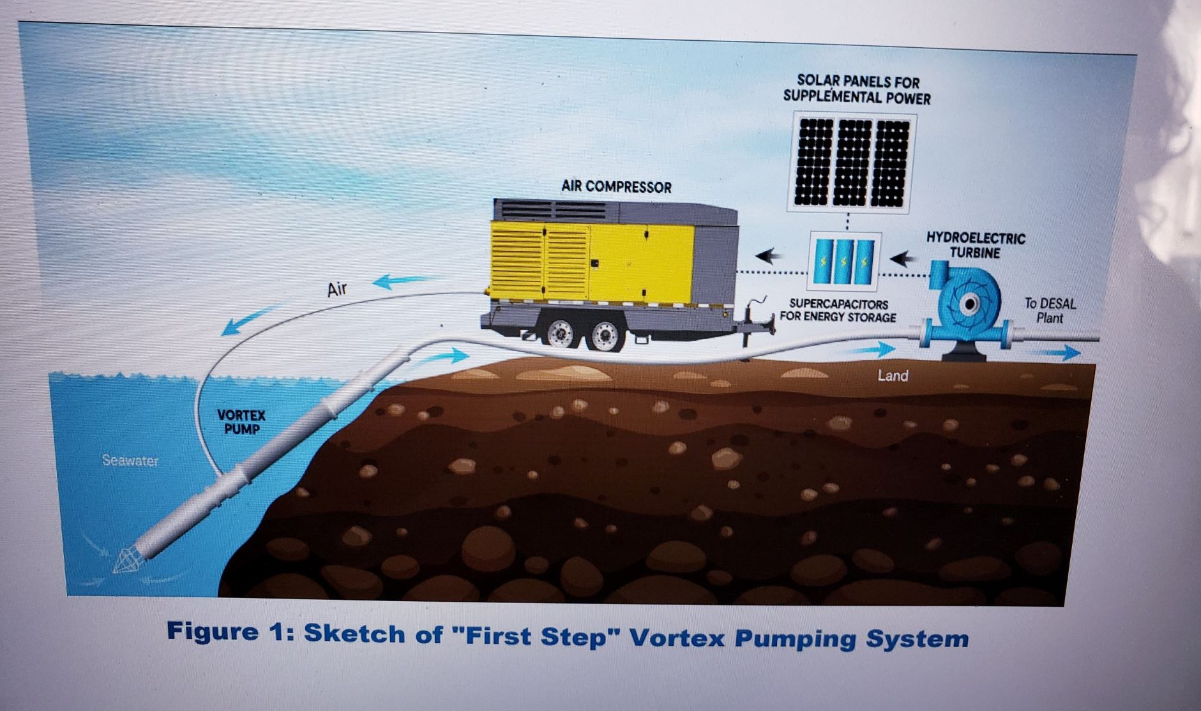
OUR TECHNOLOGY
Based upon a 1967 patent, MHD Technology repurposed a dredging device that generated a water flow rate of 20,000 gallons per minute, which is far above any other dredge was able to achieve. It is scalable. A demo prototype was tested and performed flawlessly.
Our company re-designed the dredge by turning the pipe 180 degrees, so the water was pushing, not suctioning. We added a turbine(s) to generate electricity for the robust flow rate. Part of that electricity goes to running the system eliminating the need to purchase outside energy.

Slide 5
Advantages of MHD Technology
As an independent, stand-alone system, there is no need to buy electricity for the system to function, allowing remote locations to implement the technology
It saves water companies millions of dollars a year by not purchasing fuel for their hydraulic pumps.
There are no harmful emissions.
The technology can be set up to produce electricity for sale to the grid.

Slide 6
Multiple Uses
There are multiple uses for our technology.
In addition to freshwater, the low cost of construction and operation of our pipeline allows us to offer it to agriculture companies for irrigation purposes only.
For the above reasons, licensees should consider buying presently unusable land, such as deserts, next to large bodies of saltwater seas and oceans, and irrigate and fertilize them.
These properties will be attractive to all the major agriculture companies for leasing.
The availability of unlimited, inexpensive irrigation water will cut the operating costs appreciably and make them invulnerable to droughts.

Slide 7
Multiple Uses
Another use of our technology is moving crude oil through pipelines. The power of 20,000 GPM allows moving even the heavier oil at almost the same speed as water.
Presently, the average cost of moving a barrel of oil through a pipeline is US$5.00 per barrel. There are 2,175,000 miles of oil pipelines globally that would reduce that cost drastically for a one-time-only retrofit of our technology.
This technology also applies to the presently 25,000 or more desal operating pipelines.

Slide 8
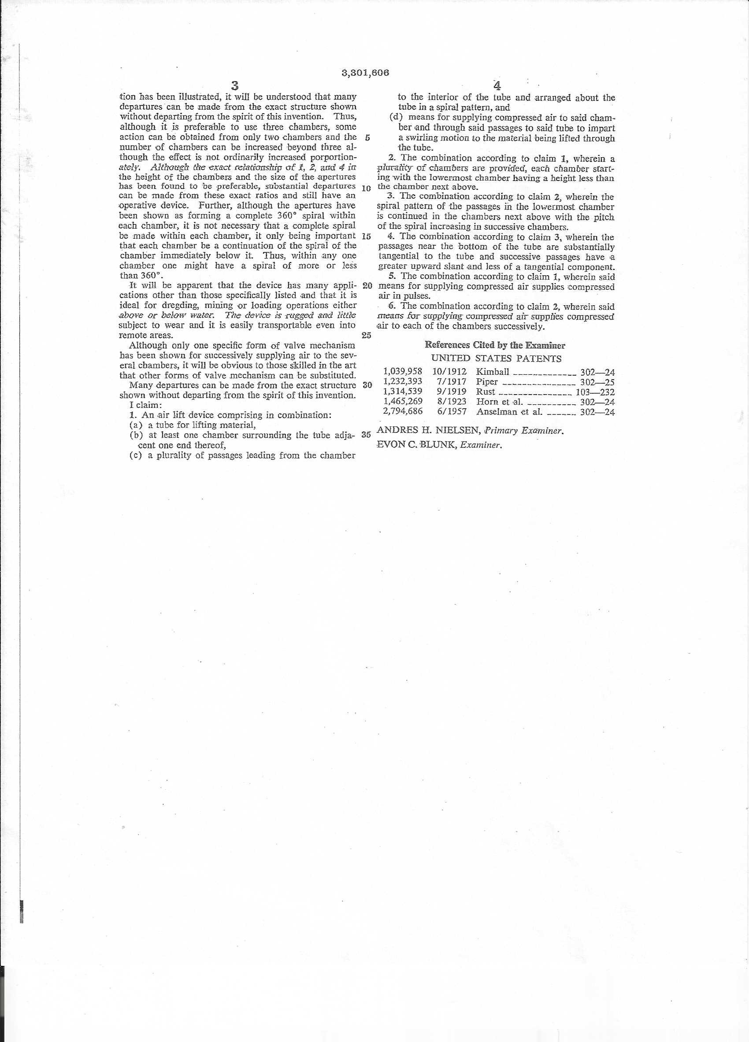
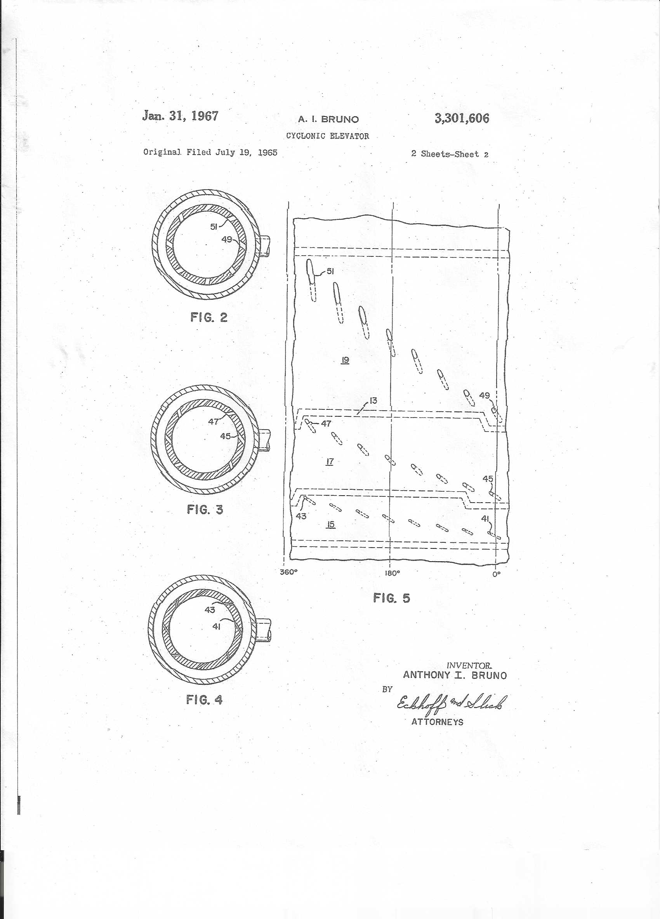
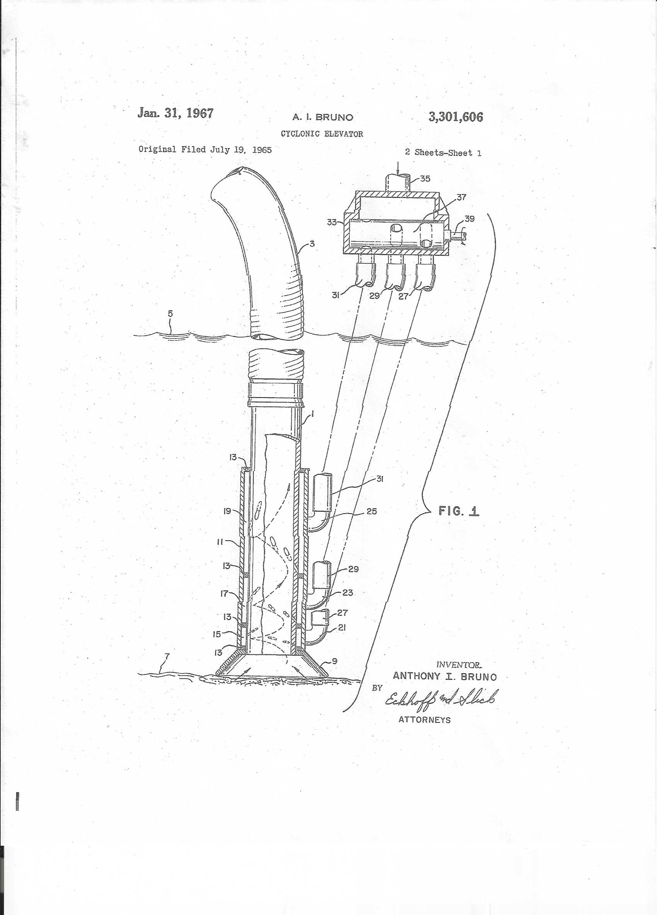
Original 1967 Patent

Slide 9
MHD Technology

